Slide 1
Abstract
A simple review of privacy-preserving location sharing scheme over mobile online social network.

Slide 2
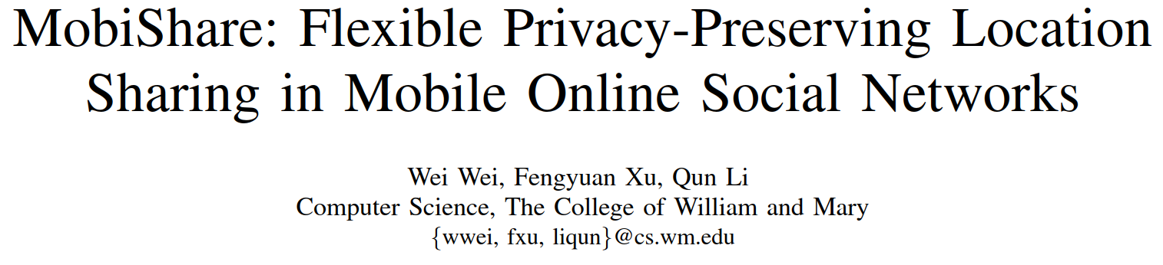

Slide 3
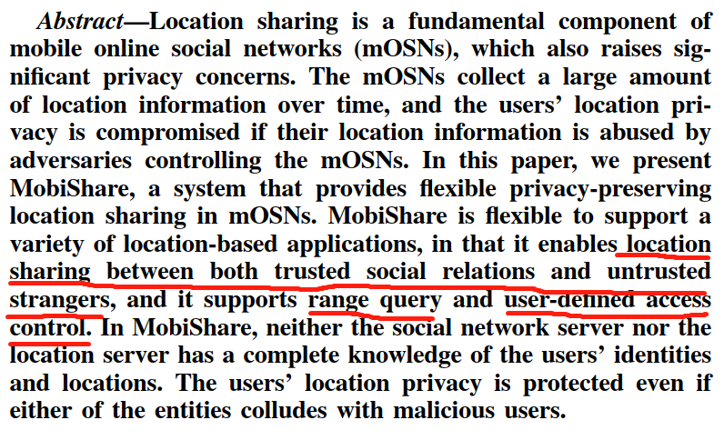

Slide 4
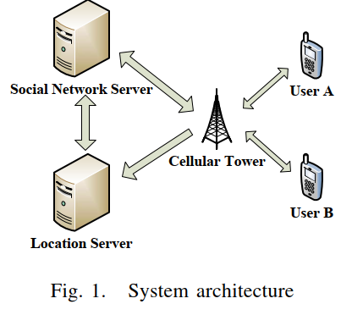
a server of any existing OSN that wants to provide the location-sharing service.
SNS:
Users’ ID and friend lists
LS:
an untrusted third-part server
Stores anonymized location updates of the users.
symmetric secret key
CT
CT:
symmetric secret key
LS
each user has a unique identifier at the social network server.
User:
a public-private key pair
social network friends
a symmetric session key

Slide 5







A. Service Registration (at SNS)
(1) User sent PubKeyA to SNS
(2) Define: access control settings (two threshold distances): dfA and dsA
User A gets
SNS stores
User A
CT
SNS
SNS
SNS sent
CT
User A
User A
OK
CT
stores

Slide 6










CT
User A
CT
CT
SNS
CT
LS

Slide 7







User A
CT
SNS
SNS
LS
LS
SNS
SNS
CT
CT
User A

Slide 8




User A
CT
CT
SNS
LS
LS
SNS
SNS
CT
CT
User A

Slide 9
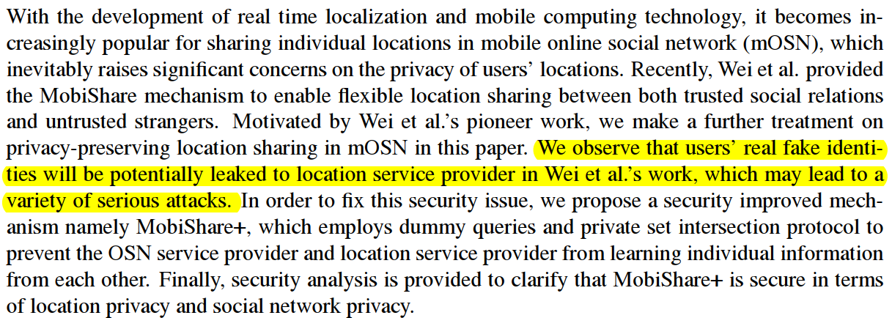

Slide 10
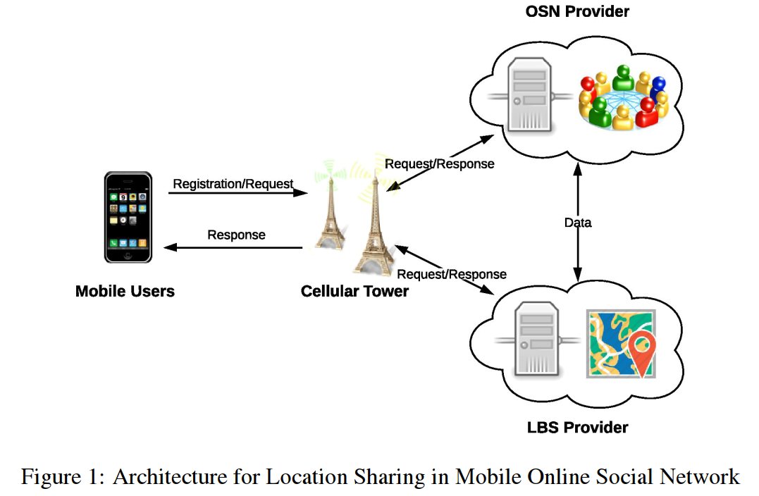

Slide 11
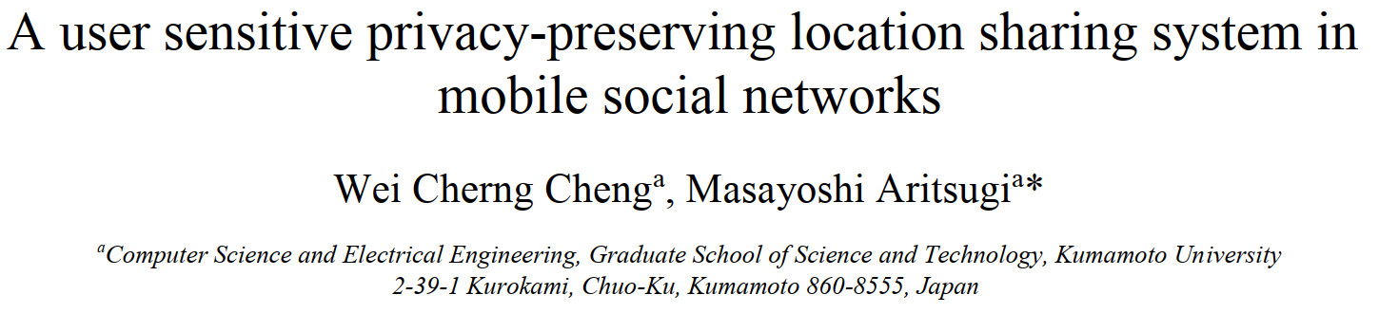
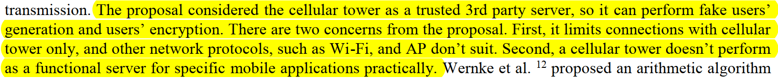

Slide 12
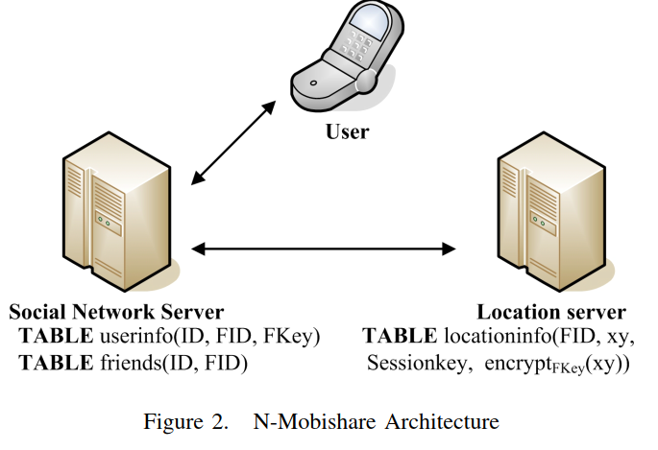
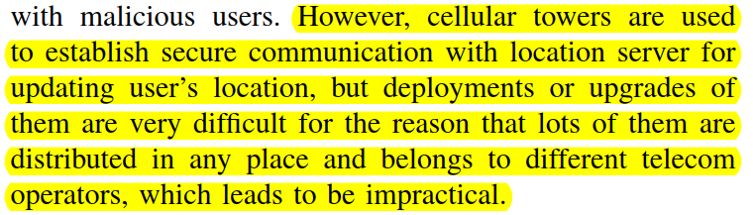

Slide 13
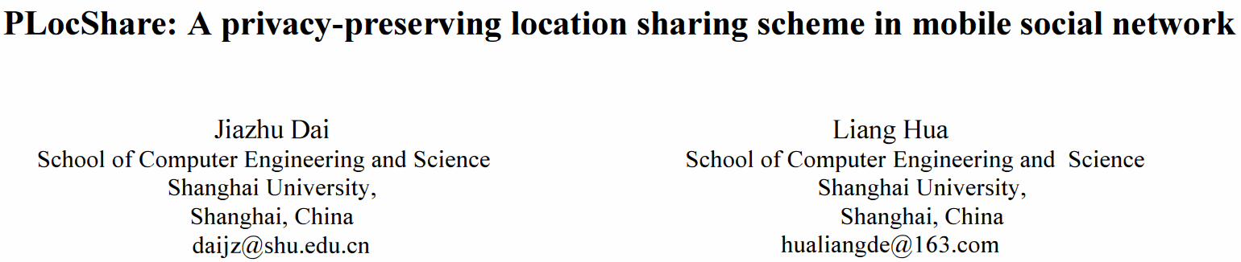
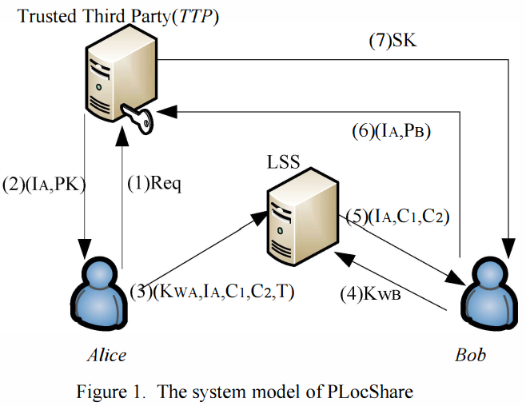

Slide 14
